Slide 1

Presentation Outline Of Healthcare Equity In Salt Lake County
Professional Master of Science and Technology Professional Experience Project
Grace Tan
Oct 17, 2021

Slide 2
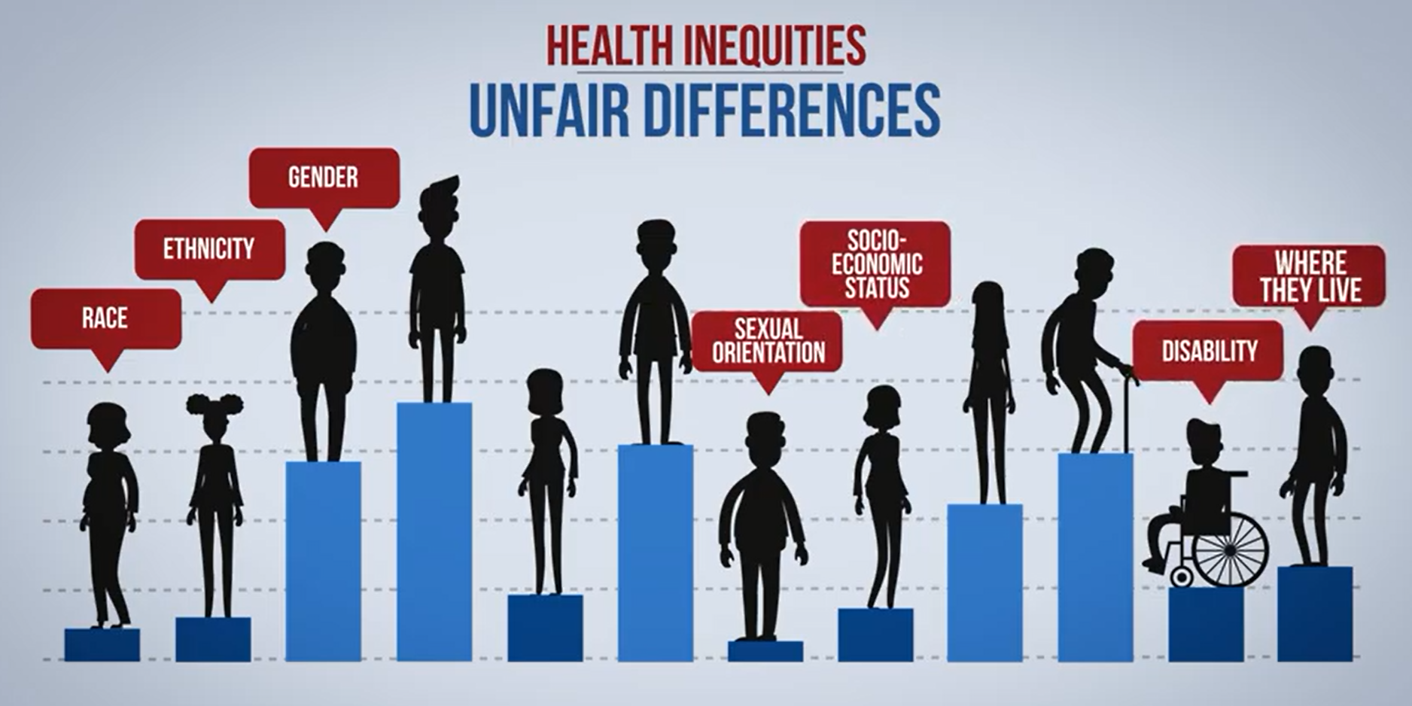
CONTENTS
1
Interest in the topic
2
Description of issues with “equity”
3
Proposed analysis and expected
outcomes
4
Summary
Source: Engaging Healthcare Teams to Eliminate Health Inequities

Slide 3
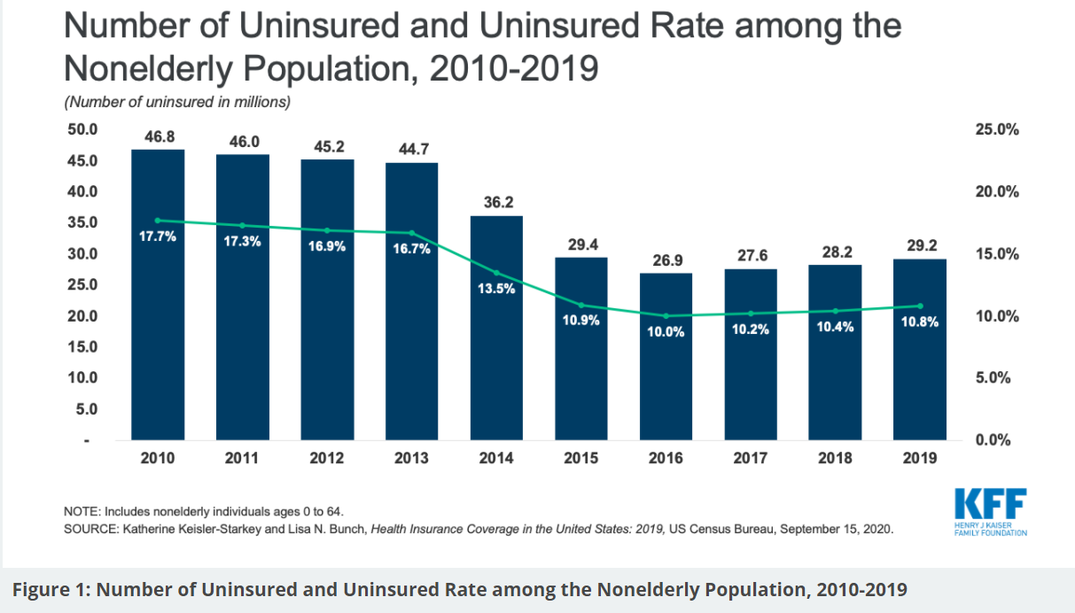
1 Why the topic?
• Medical services reflect the basic need of individuals.
• We use the health insurance rate as the proxy for healthcare equity in the project.
• After historic declines in the number of uninsured people and the uninsured rate following the adoption and implementation of the 2010 Affordable Care Act (ACA), resulting in nearly 20 million more people covered through 2016, the number and rate of nonelderly uninsured people began to increase in 2017.
Source: What We Do and Don’t Know About Recent Trends in Health Insurance Coverage in the US
Notes:
Medical services reflect the basic need of individuals. In the face of illness and pain, everyone should have the same opportunities to access adequate medical services regardless of their income, wealth, race, region, etc.
Due to limited use of the public dataset, we don't have specific data to reflect health services. For example, for how many times does one person go to the hospital one year? How much money have they spent on it? We use the health insurance rate as the proxy for healthcare equity in the project.
According to "What We Do and Don't Know About Recent Trends in Health Insurance Coverage in the US," "Prior to the pandemic, the uninsured rate had been increasing incrementally for several years despite an improving economy. After historic declines in the number of uninsured people and the uninsured rate following the adoption and implementation of the 2010 Affordable Care Act (ACA), resulting in nearly 20 million more people covered through 2016, the number and rate of nonelderly uninsured people began to increase in 2017. The uninsured count grew from 26.7 million (10.0%) in 2016 to 27.6 million (10.2%) in 2017, 28.2 million (10.4%) in 2018, and, as was announced this week, 29.2 million (10.8%) in 2019 (Figure 1)."

Slide 4
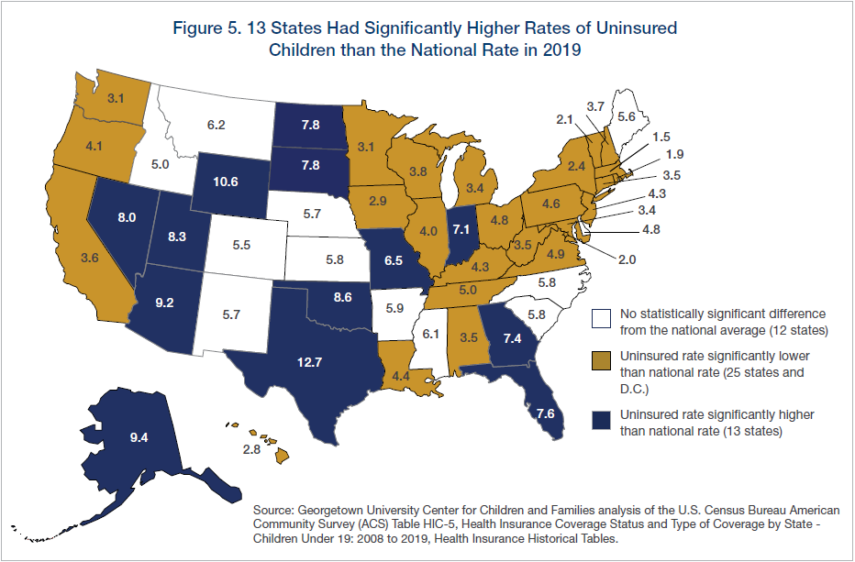
1 Why the topic?
According to recent census data, Utah has 82,000 children without health insurance. An estimated 8.3% of children in Utah do not have health insurance, and the state ranks 46th — among the worst in the country — for rates of uninsured children.
Source: Utah has one of the highest rates of uninsured kids. Could insuring them save taxpayers millions?

Slide 5
2 Description of issues with “equity”
1
Definitions
2
Assumptions
From the statistics and graphs of the uninsured rates in the sates of USA, we assume that there is health inequity in Salt Lake County .
3
Prior work
literature highlights O'Donnell, Owen, et al. Analyzing Health Equity Using Household Survey Data: A Guide to Techniques and Their Implementation. World Bank Publications, 2007.
4
Public datasets
U.S. Census

Slide 6
2.1 Definitions
1
Equity in health care can mean equal utilization, distribution according to need, equal access, equal health outcomes (Culyer &Wagstaff 1993 (24)).
2
Margaret Whitehead put the definition of health equity in The Concepts and Principles of Equity in Health that: "as equal access to available care for equal need, equal utilization for equal need, equal quality of care for all."
3
She held the view on health inequity that "are not only unnecessary and avoidable but, in addition, are considered unfair and unjust."

Slide 7
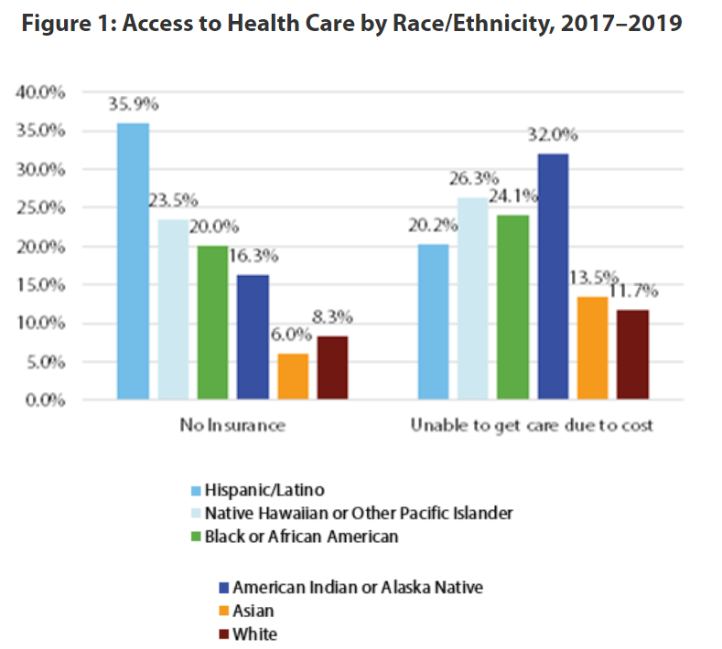
2.2 Assumptions
1
As COVID-19 continues to spread, data reveal unequal impacts across population groups. The Hispanic/Latino population is Utah’s largest minority group. While they make up 14.2% of the state’s population, they account for 29.5% of COVID-19 cases and 20.9% of COVID-19 deaths.
2
Health care access and utilization—Health insurance rates vary widely by race/ethnicity as seen in Figure 1. More than 35% of Utah’s Hispanic/Latino population has no health insurance, compared with only 8.3% of the white population. Additionally, Figure 1 shows that cost frequently prohibits minority populations from receiving needed care.
Source: Utah Department of Health 2017–2019 Behavioral Risk Factor Surveillance System (BRFSS) Data

Slide 8
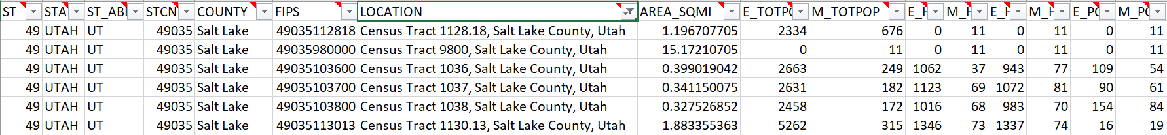
2.3 Prior work
1
literature highlights
O'Donnell, Owen, et al. Analyzing Health Equity Using Household Survey Data: A Guide to Techniques and Their Implementation. World Bank Publications, 2007.
This book shows how to decompose inequalities in a health variable (be it a health outcome or utilization) into contributions from different sources—the contribution from education inequalities, the contribution from insurance coverage inequalities, and so on. One chapter shows the reader how to apply the method through worked examples complete with Stata code.
2
Social Vulnerability Index
SVI indicates the relative vulnerability of every U.S. Census tract. SVI ranks the tracts on 15 social factors, including unemployment, minority status, and disability, and further groups them into four related themes. Thus, each tract receives a ranking for each Census variable and for each of the four themes, as well as an overall ranking.
3
Community Resilience Estimates for Disaster Preparedness.

Slide 9
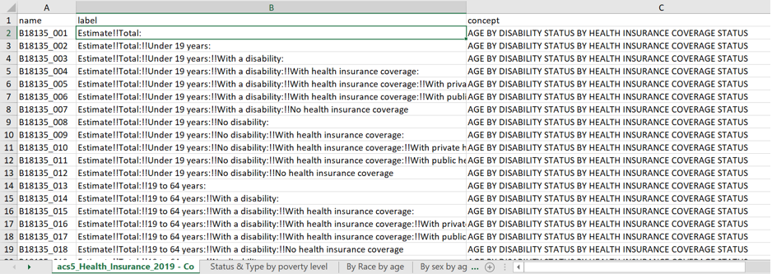
2.4 Public datasets
1
ACS5
This project uses 5-year American Community Survey Data (2015-2019) for analysis. It includes health insurance coverage status by sex by age, types of health insurance coverage by age, health insurance coverage status and type by household income, health insurance coverage status by age (race).
2
Example:
• Load variables of ACS5 with the concept "HEALTH INSURANCE" using R package tidycensus.
More details in full proposal. The Health insurance coverage rate in South Jordan under 1.00 of poverty threshold under 19 years is 97%(sum of Under 1.00 poverty Under 19 years with health insurance in South Jordan/sum of Under 1.00 poverty Under 19 years total in South Jordan).

Slide 10
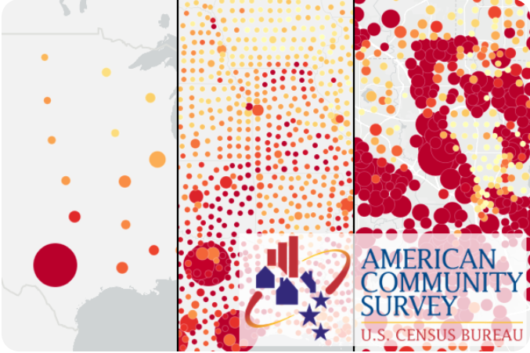
3 Proposed analysis and expected outcomes
1
Blinder-Oaxaca decomposition
Theory
Example
Proposed analysis
2
Graphical analysis at the tract and city level
3
GitHub repository

Slide 11
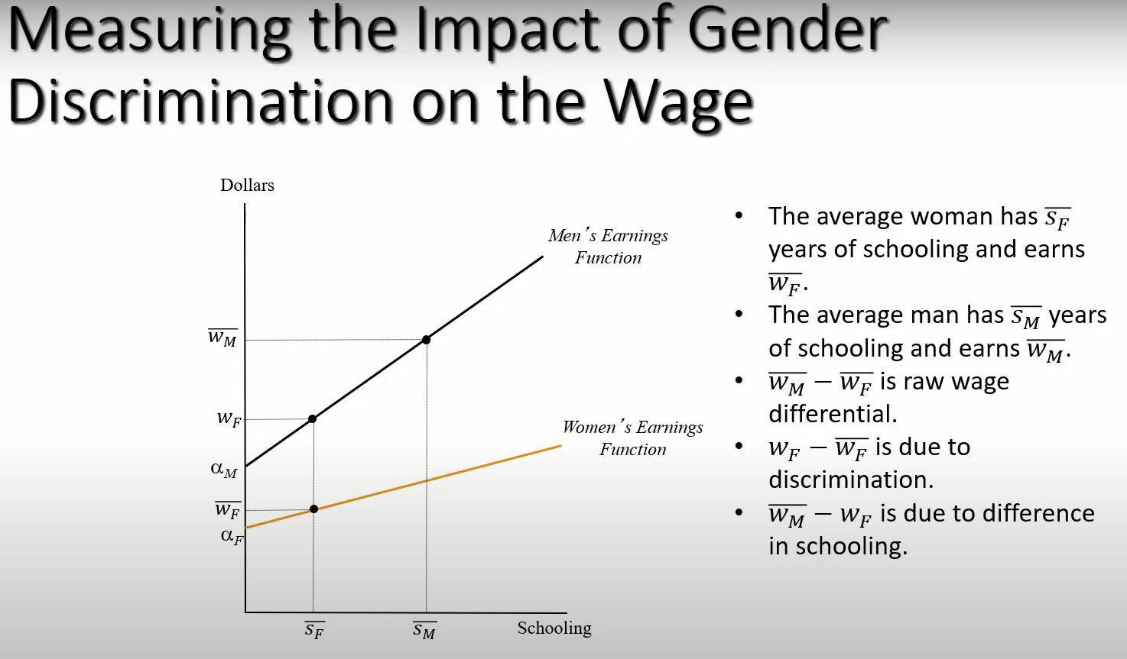
3.1.1 The Blinder-Oaxaca decomposition Theory
1
Theory
Blinder-Oaxaca decomposition is a statistical method that decomposes the gap in mean outcomes across two groups into a portion that is due to differences in group characteristics and a portion that cannot be explained by such differences.
Notes:
Theory: The Blinder-Oaxaca decomposition is widely used to analyze types of inequity in sociology research. It is a statistical method that decomposes the gap in mean outcomes across two groups into a portion that is due to differences in group characteristics and a portion that cannot be explained by such differences.
This method has been most widely used to study gender- and race-based discrimination in the labor market; Blinder-Oaxaca decompositions can be applied to explain differences in any continuous outcome across any two groups.

Slide 12
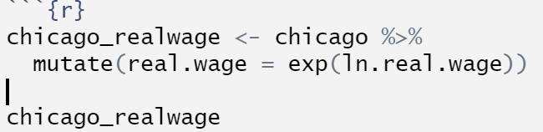
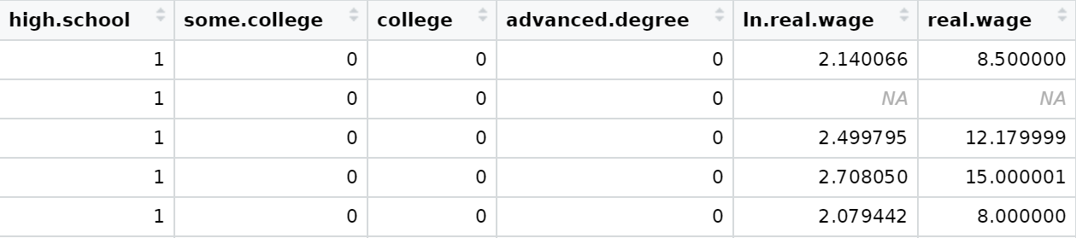
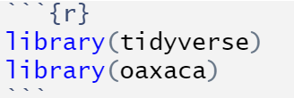
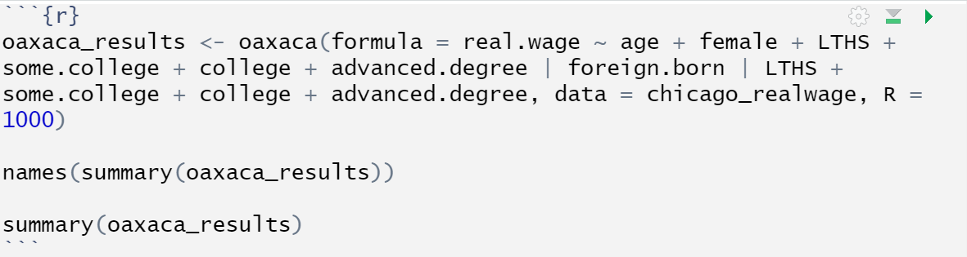
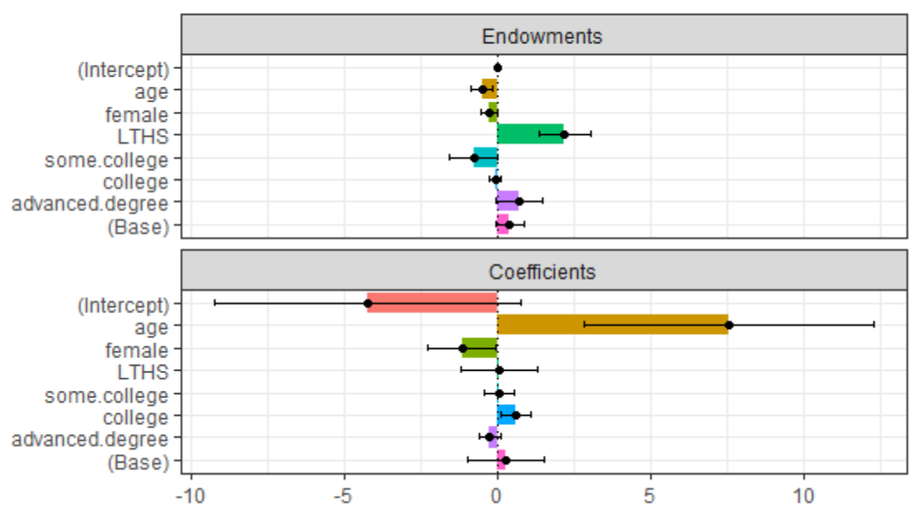
3.1.2 The Blinder-Oaxaca decomposition Example
a
Import oaxaca package and Chicago dataset
b
Call the oaxaca() function to estimatethe relative magnitudes of these channels’ influence
c
Visualization: Method plot()
Notes:
a:
According to “oaxaca: Blinder-Oaxaca Decomposition in R” by Marek Hlavac, we will use the oaxaca package to do the Blinder-Oaxaca decomposition. We use dataset “Chicago”. The Chicago data frame contains information about the demographic characteristics and labor market outcomes of 712 employed Hispanic workers in the Chicago metropolitan area. This example explains the wage gap between native and foreign-born Hispanic workers.
b:
where real.wage is the dependent variable, age + female + LTHS + some.college + college + advanced.degree are explanatory variables and foreign.born is an indicator variable that is TRUE (or equal to 1) when an observation belongs to Group B, and FALSE (or equal to 0) when it belongs to Group A. Here, LTHS + some.college + college + advanced.degree are indicator ("dummy") variables that will be adjusted so that the decomposition results do not change depending on the user's choice of the reference category. Data...is the data frame used in the decomposition. R is number of bootstrapping replicates for the calculation of standard errors.
c:
The oaxaca package can produce easily customizable bar charts that visually summarize the
results of its Blinder-Oaxaca decompositions.

Slide 13

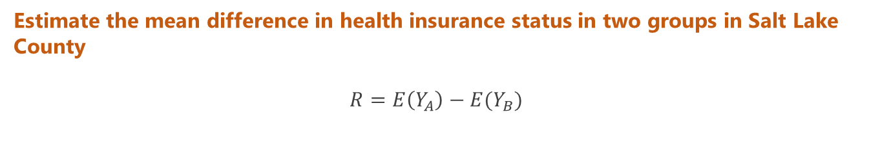
3.1.3 The Blinder-Oaxaca decomposition Proposed analysis
a
Build a regression equation
$$Y=α+β⋅X_{1}+γ⋅X_{2}+ϵ$$
Y - Health insurance availability in a city
X_1- Pre-restraining factors (age, etc.)
X_2 - Discrimination factors (poverty level, race, sex, education attainment)
β- Coefficient of Pre-restraining factors
γ- Coefficient of Discrimination factors
ϵ - error
We refer to SVI paper and establish “groups.”
b
Estimate the mean difference in health insurance status in two groups in Salt Lake County
$$R=E\left(Y_{A}\right)−E(Y_{B})$$
Notes:
Proposed analysis:
I will build a regression equation for two groups in Salt Lake County. Because USA uninsured rate among the nonelderly population in 2019 is 10.8%, we set the uninsured rate at 0.1 as a "risk" level. One group is all of the tracts whose insured rate is less than 0.9. This is a high-risk group. Another group is all of the tracts whose insured rate is more than 0.9.
$$Y=α+β⋅X_{1}+γ⋅X_{2}+ϵ$$
$Y$ - Health insurance availability in a city
$X_{1}$- Pre-restraining factors (age, etc.)
$X_{2}$ - Discrimination factors (poverty level, race, sex, education attainment)
$β$- Coefficient of Pre-restraining factors
$γ$- Coefficient of Discrimination factors
$ϵ$ - error
We refer to SVI paper and establish “groups.”
b. I will refer to Jann, Ben (2008) The Blinder-Oaxaca decomposition for linear regression models and use Blinder–Oaxaca decomposition here because it is widely used to analyze types of inequity in sociology research. I will estimate the mean difference in health insurance status in two groups in Salt Lake County. That is,
$$R=E\left(Y_{A}\right)−E(Y_{B})$$
$Y_{A}$- Health Insurance Availability in Group A
$Y_{B}$- Health Insurance Availability in Group B

Slide 14
3.2 Graphical analysis at the tract and city level
1
We will explore how factors such as age, sex, poverty level, race, educational attainment, etc.) account for the health equity gap and drive healthcare inequity. Then I want to apply the research results in different cities. We haven't started the analysis yet.
2
We will produce maps of uninsured rates across the major cities of Salt Lake County to visualize how different groups and factors are distributed. The expected result is like this example.

Slide 15
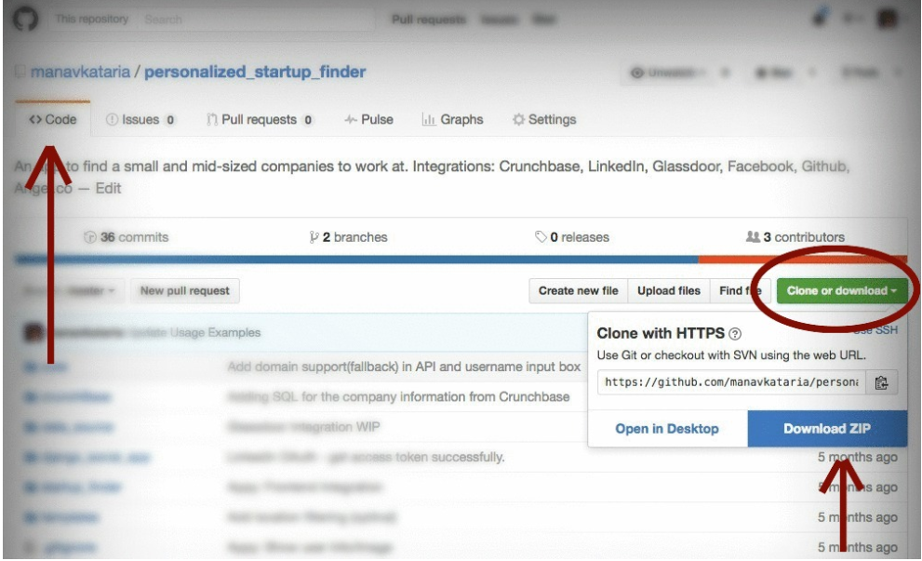


3.3 GitHub repository
GitHub is a software source code hosting service platform for version control through Git . It is the world's largest code storage website and open source Community.
I am now pursuing a master's degree in Computational and Data Science, emphasizing statistics, and currently seeking a data analysis research job at a health care institution. To share this work, I will publish the analysis and work summary as a GitHub repository so that introduce myself to the potential employer.
1
Create a new repository
2
Upload files to GitHub
3
Direct URLs for GitHub Files

Slide 16

4 Summary
It is complex to analyze health equity in Salt Lake County. We only consider main factors age, sex, poverty level, race, and education attainment. We don't include their career for different races and sex, how much money people could afford medical services, the different insurance types coverages. Health equity is a long path which we would unite to struggle together.

Slide 17
Thank You!

